Slide 1
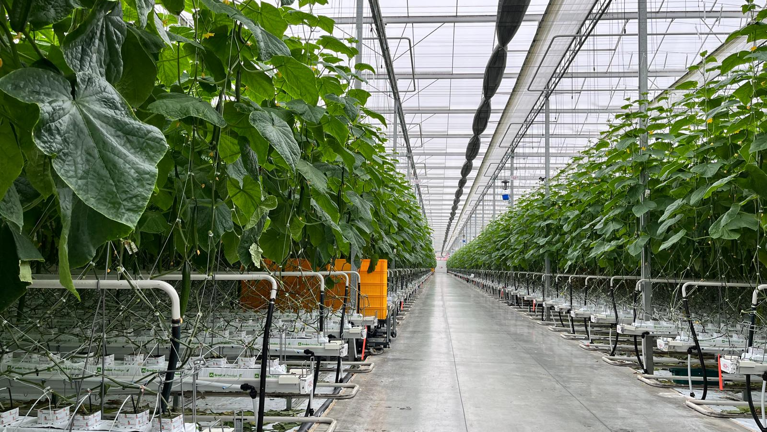
Increasing yield of Crop Production in Greenhouses using AI
Capstone Project Team – Group 5
Yellai Aditya Venkat Murty – 0801899
Odunayo Agagu – 0810500
Khushi Patel – 0790434
Suman Sunny Rathod – 0815907
Naveen Kumar Reddy Sama – 0804315

Slide 2
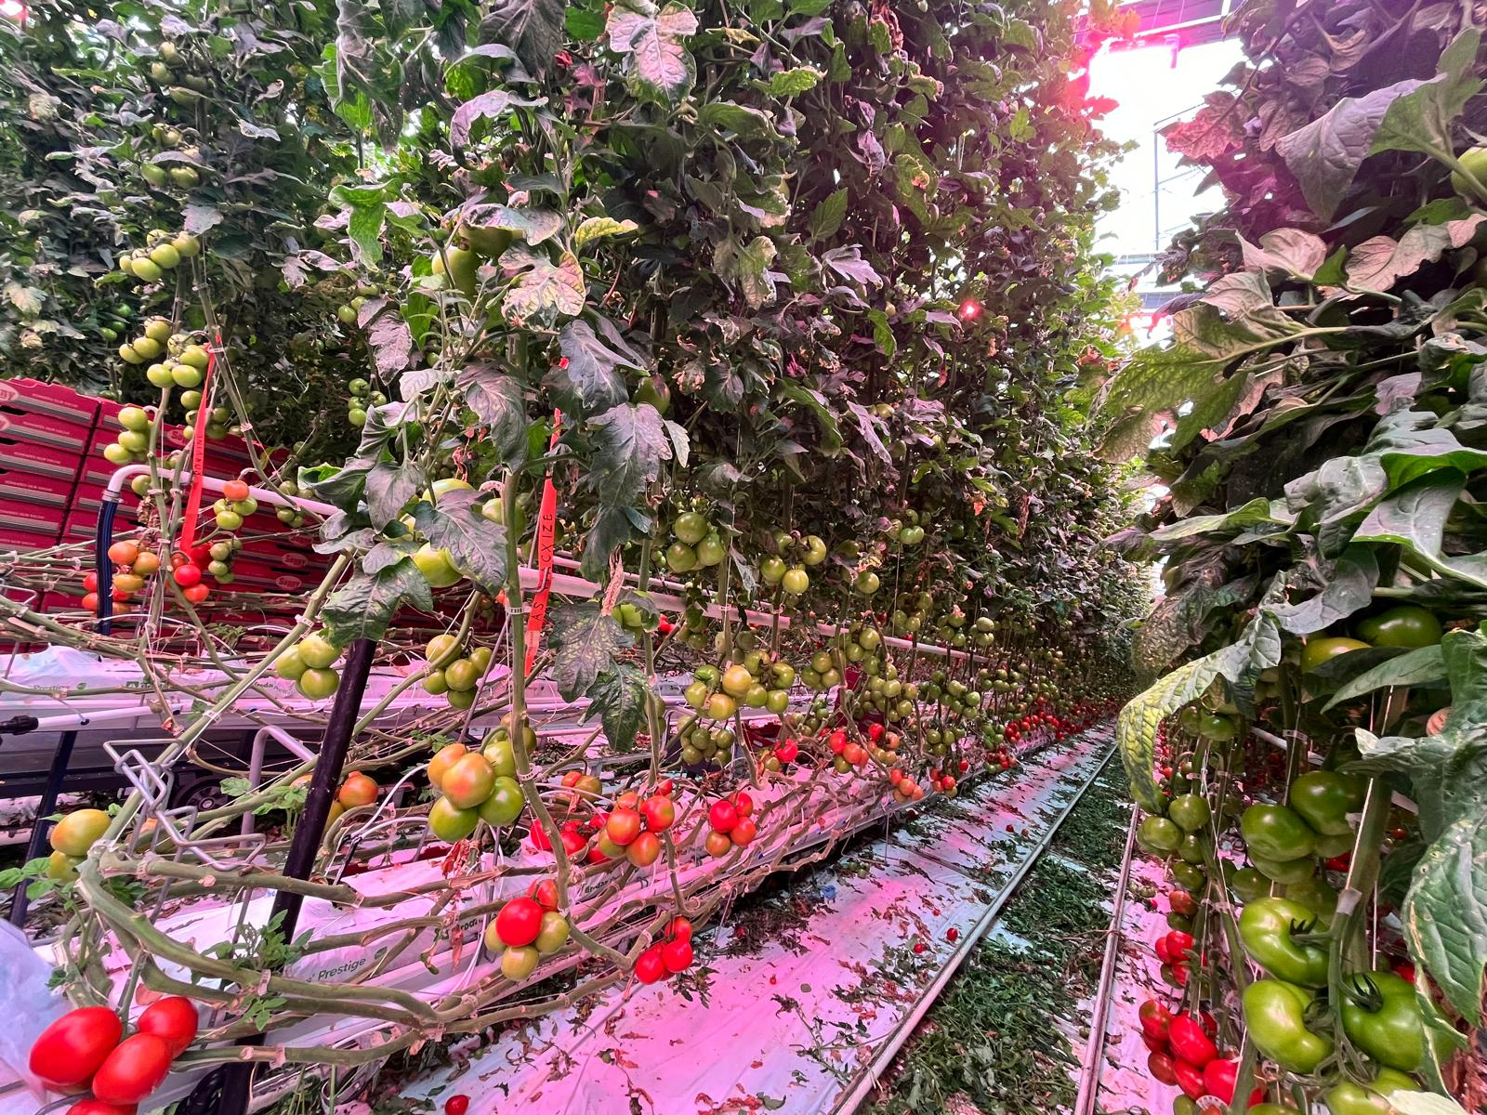
Agenda
Problem Statement
Dataset Information
Methodology
Dashboards
Key Insights
Data collection
Greenhouse Visit
Machine Learning Models
Use Case
Challenges

Slide 3

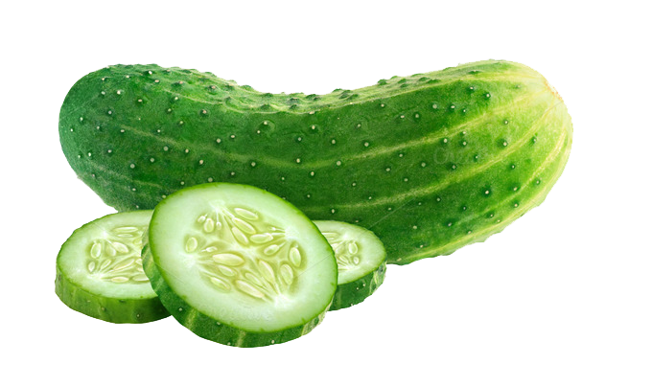
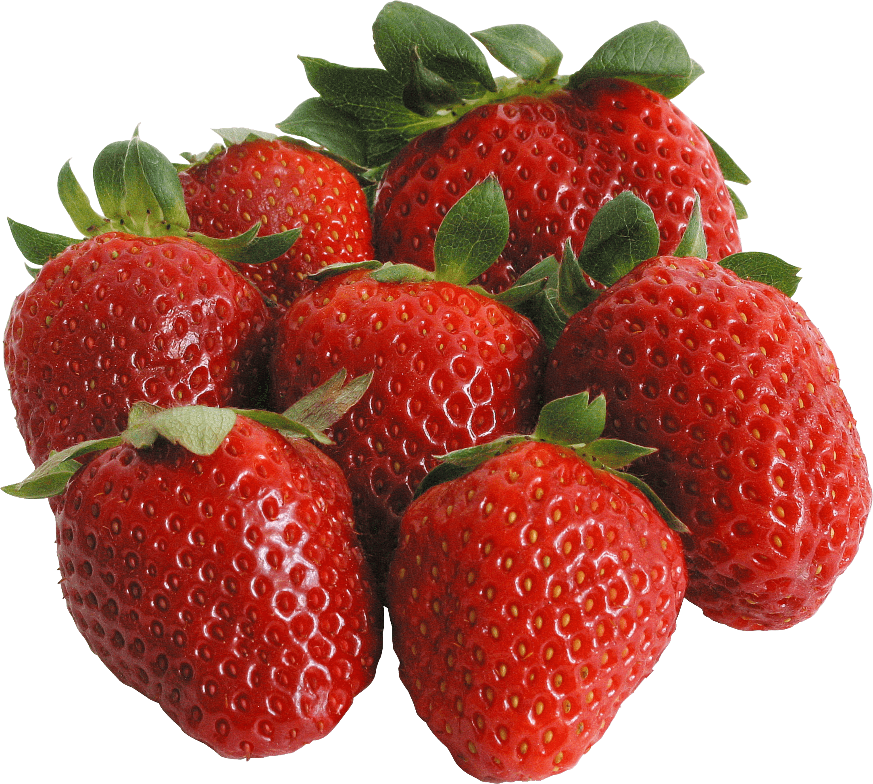
Problem Statement
Issue
The agriculture sector is faced with challenge of optimizing yield and managing crop disease amidst increasing population and dwindling resources. Greenhouses – major form of crop growing environment in Canada will be the focal point of consideration.
Concerns Crop Damage, Resource inefficiency, environmental damage and economic loss resulting from surplus/waste.
Goal
Crop Analyze production, current practices and major crops grown in greenhouses across Canada.
Optimize issue faced with respect to planting, managing diseases in crop to optimize yield. Help adopt best practices suitable for countering disease infestation with efficiency and speed.

Slide 4
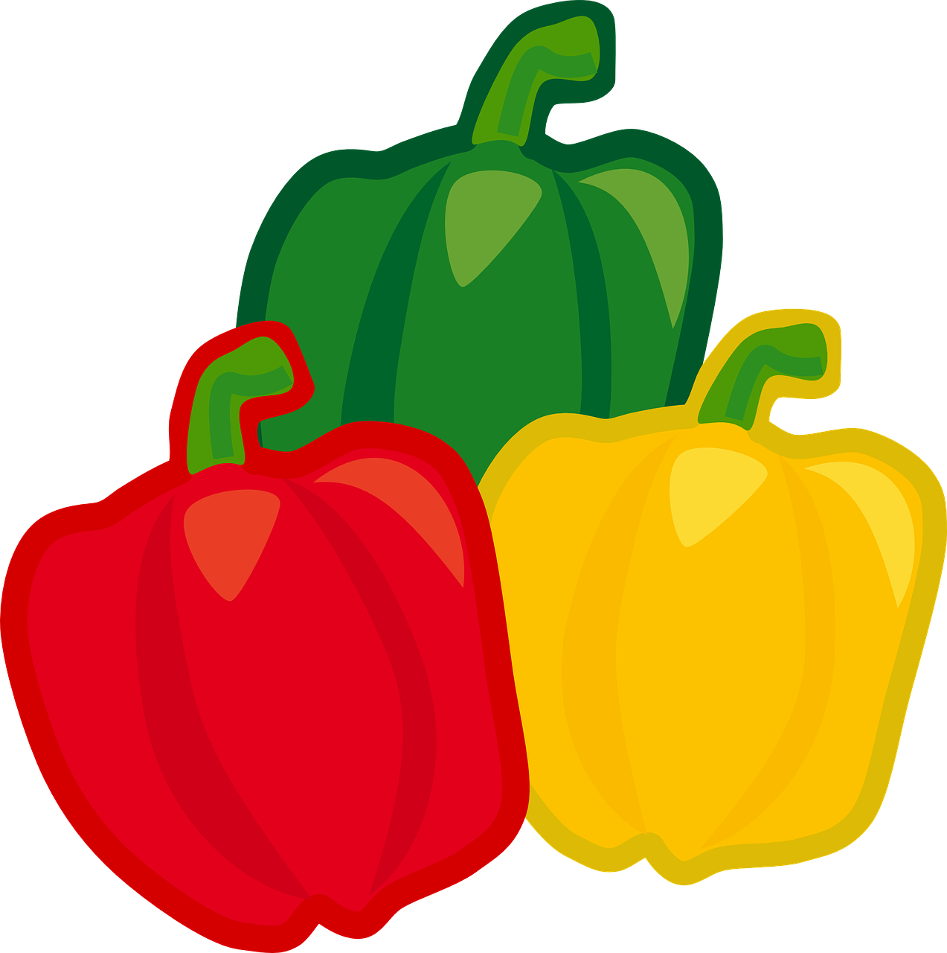




Dataset Information
Source
Image Dataset
https://www150.statcan.gc.ca/ https://universe.roboflow.com/search
Five Identified major crop disease images (leaves)
Relational Dataset
Database
Phase 1: Excel fed into tableau
Phase2: JPG images managed via Roboflow
Greenhouses: area covered, major crops grown, yield, import & export

Slide 5
Methodology
Data Collection (relational)
Cleaning & EDA
Visualization
Insight
Insight based expansion
Industry meetings & visit
Data collection (images)
Preprocessing & Labelling
ML Models
Instance Segmentation (Classification)
Training, Validation & Testing

Slide 6
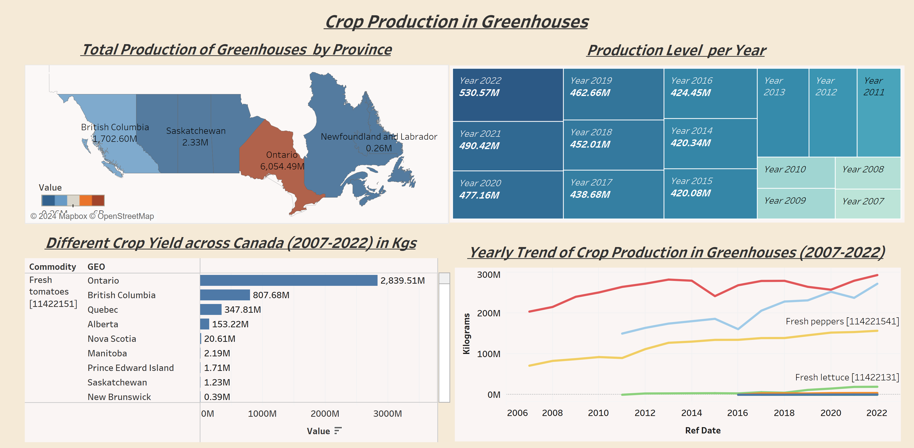
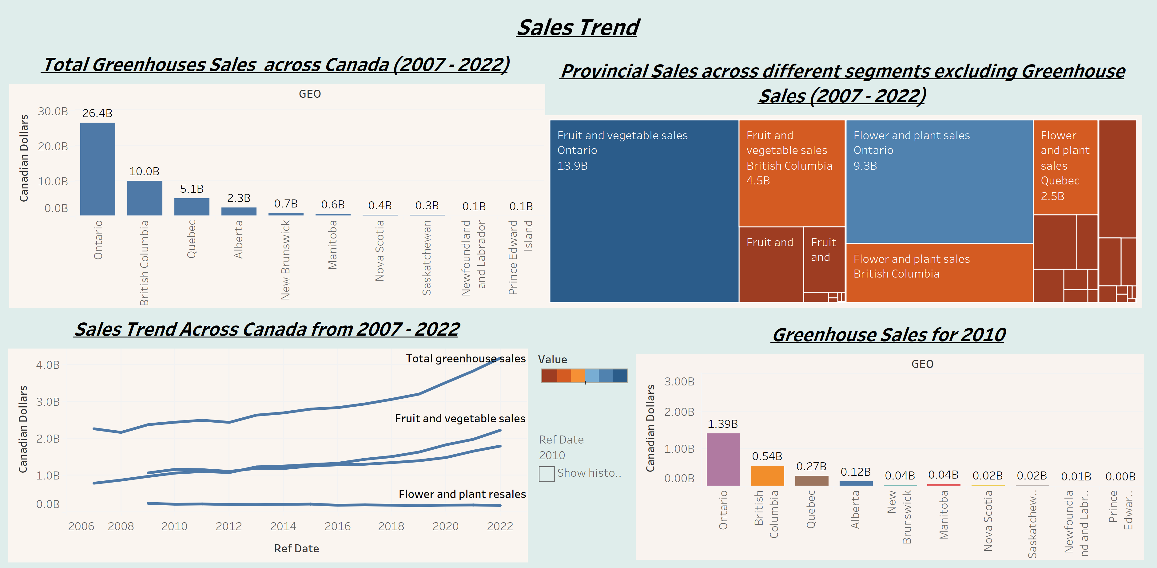
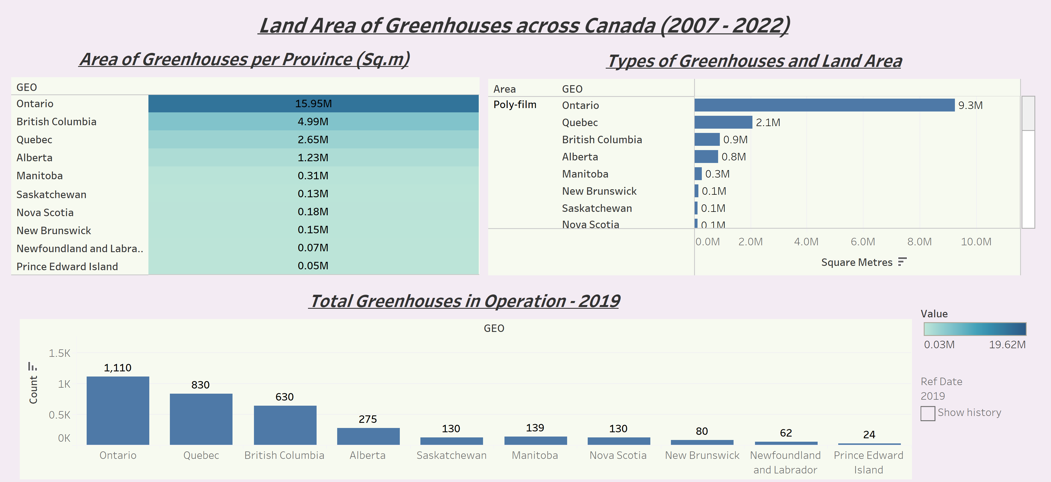
Dashboards

Slide 7
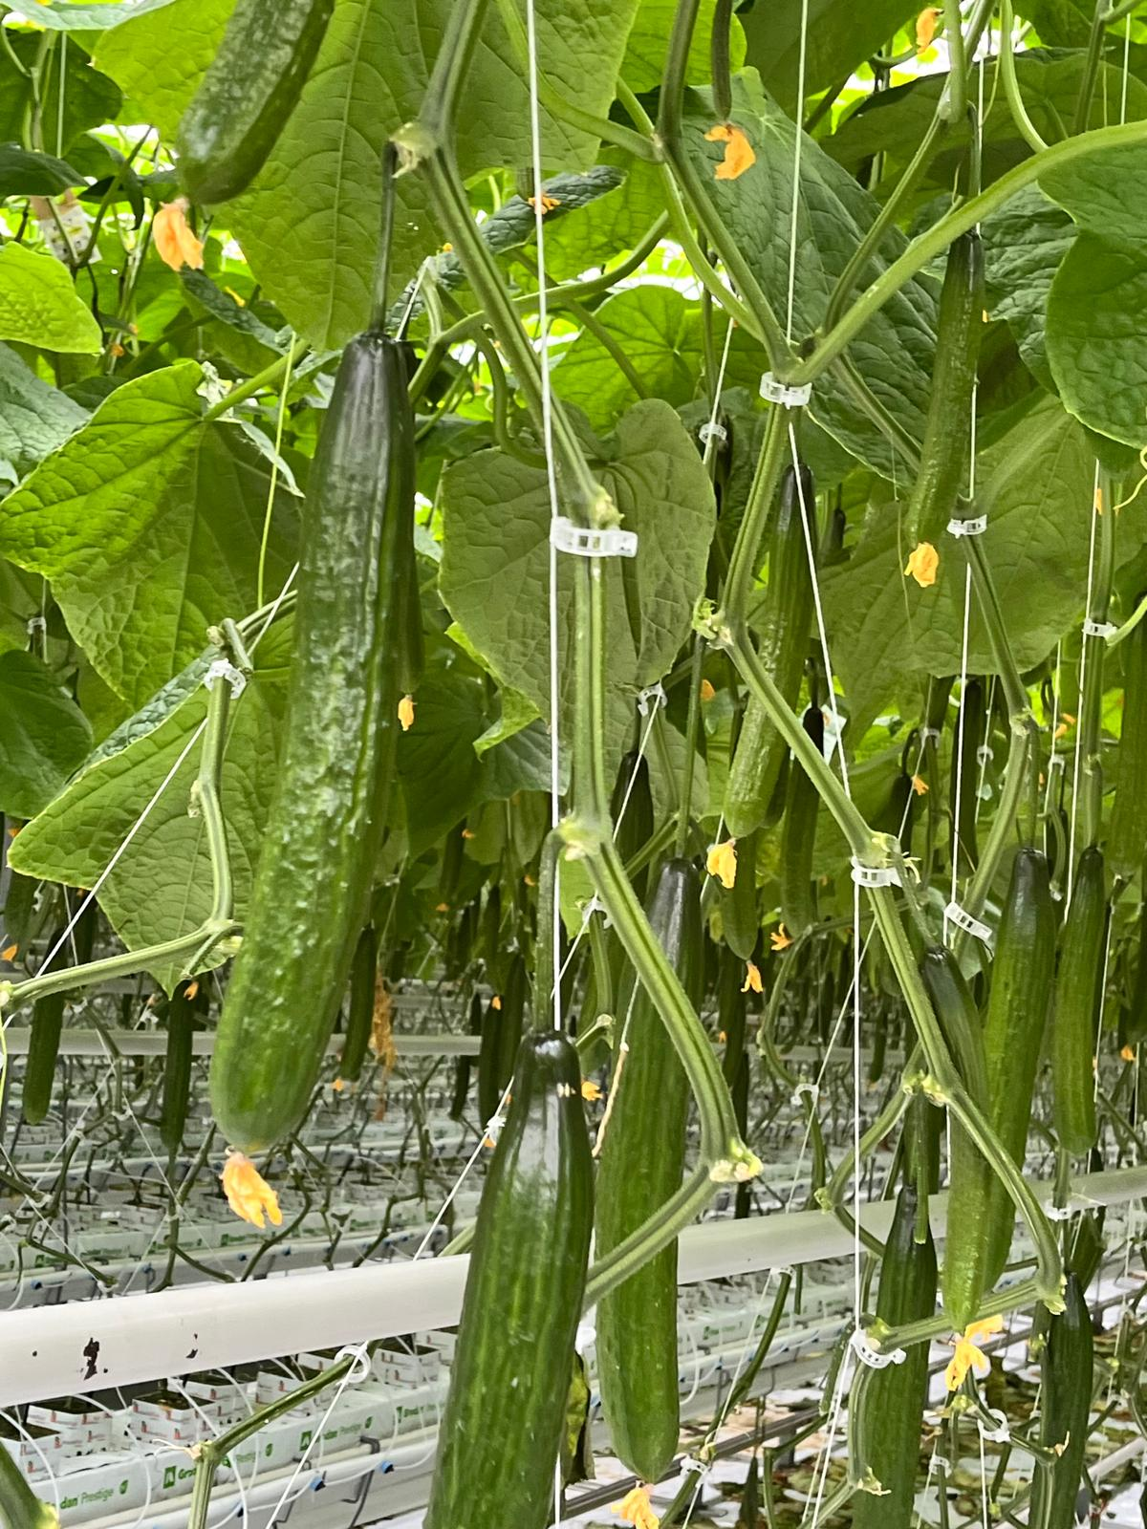
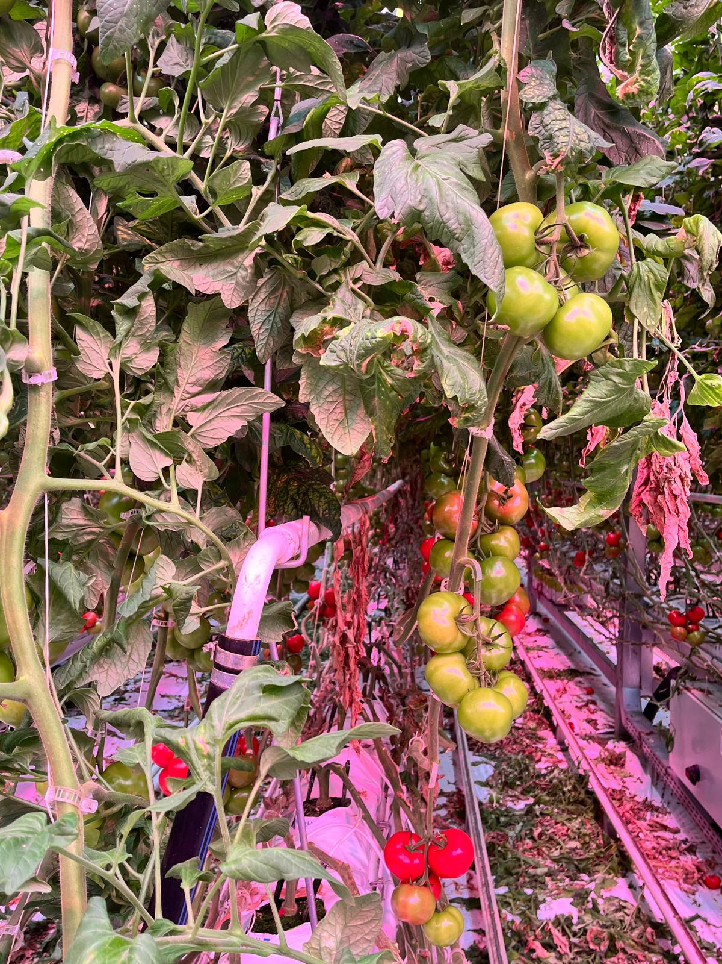
Key Insights
The three (3) provinces that account for the highest greenhouses (in terms of number, total area, production and sales) in Canada are Ontario, British Columbia and Quebec.
The major commodities produced in greenhouses are tomatoes, cucumbers and peppers. Followed by lettuce, strawberries and eggplants.
The greenhouses are either made of poly-film, glass or rigid plastic. Poly-film made greenhouse cover the largest land area

Slide 8


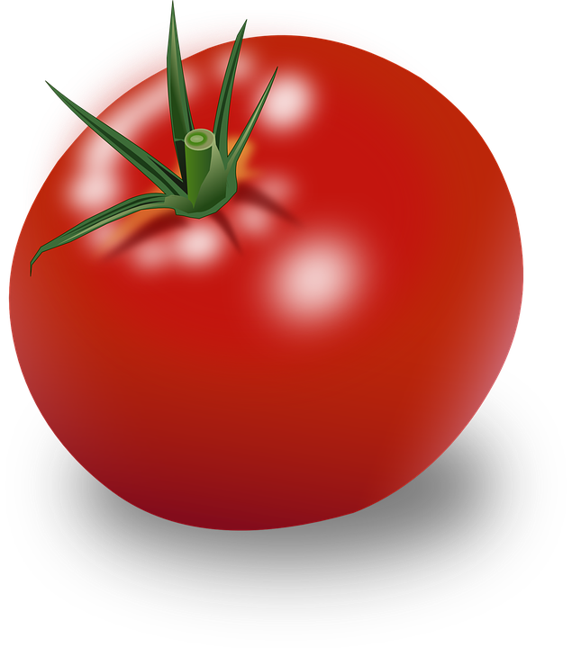
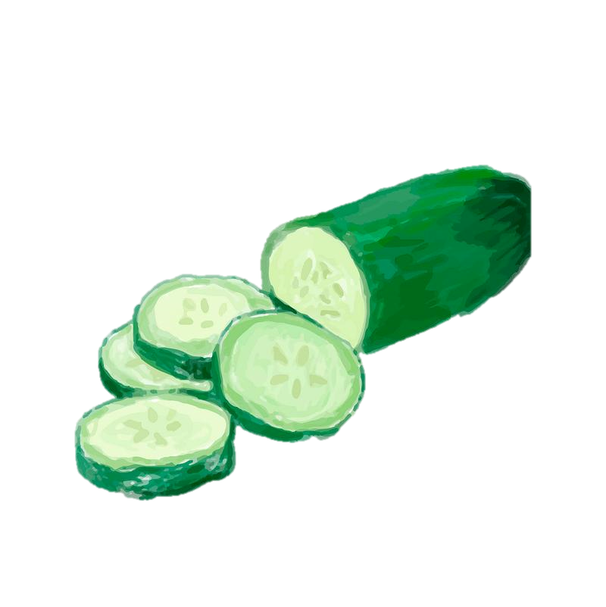
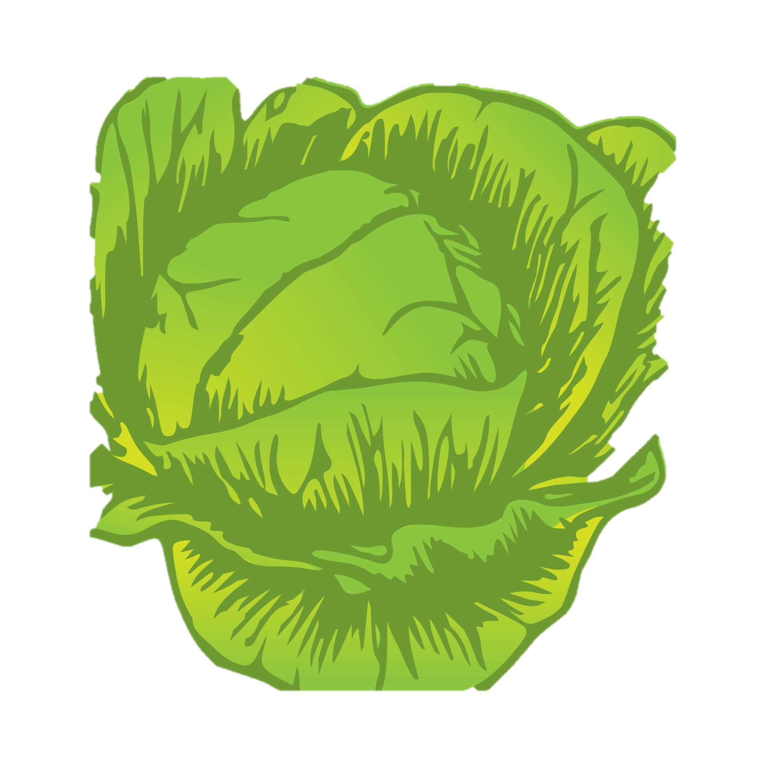
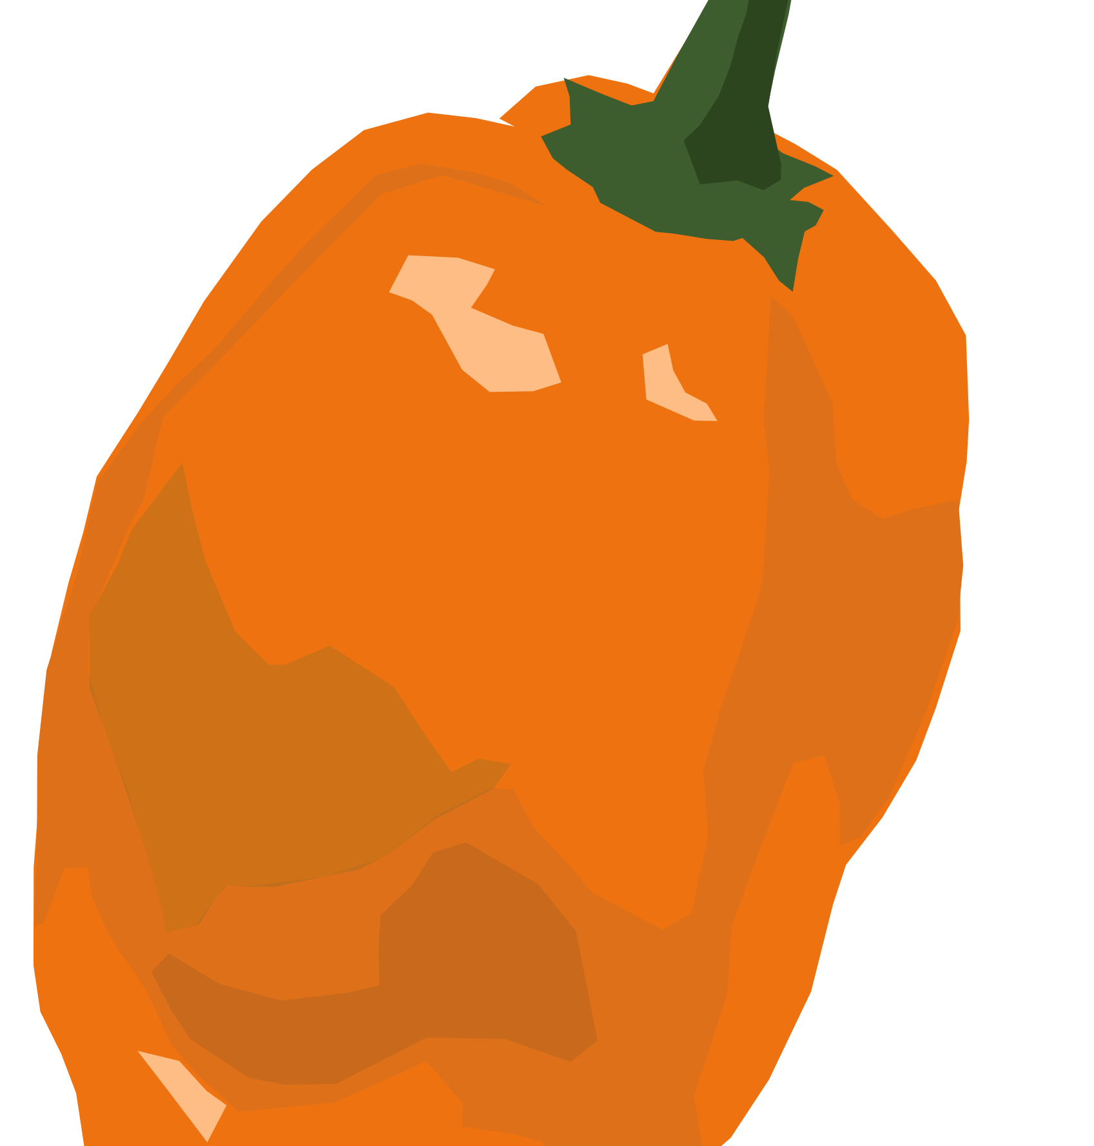
Image Data Collection - Crops
Tomato
Cucumber
Strawberry
Lettuce
Bell Pepper
Data Collection – 5 crops, 2 major diseases each. (Collect Images from Roboflow/google)
Classify – 1. Healthy / Unhealthy (Binary) 2. Disease classification (multi)
Preprocessing – sort in folder, remove duplicates, rename and resize
Labelling – Manual annotation, highlight infected segments in images for training
Augmentation – Use robolow to complete augmentation of labelled dataset

Slide 9
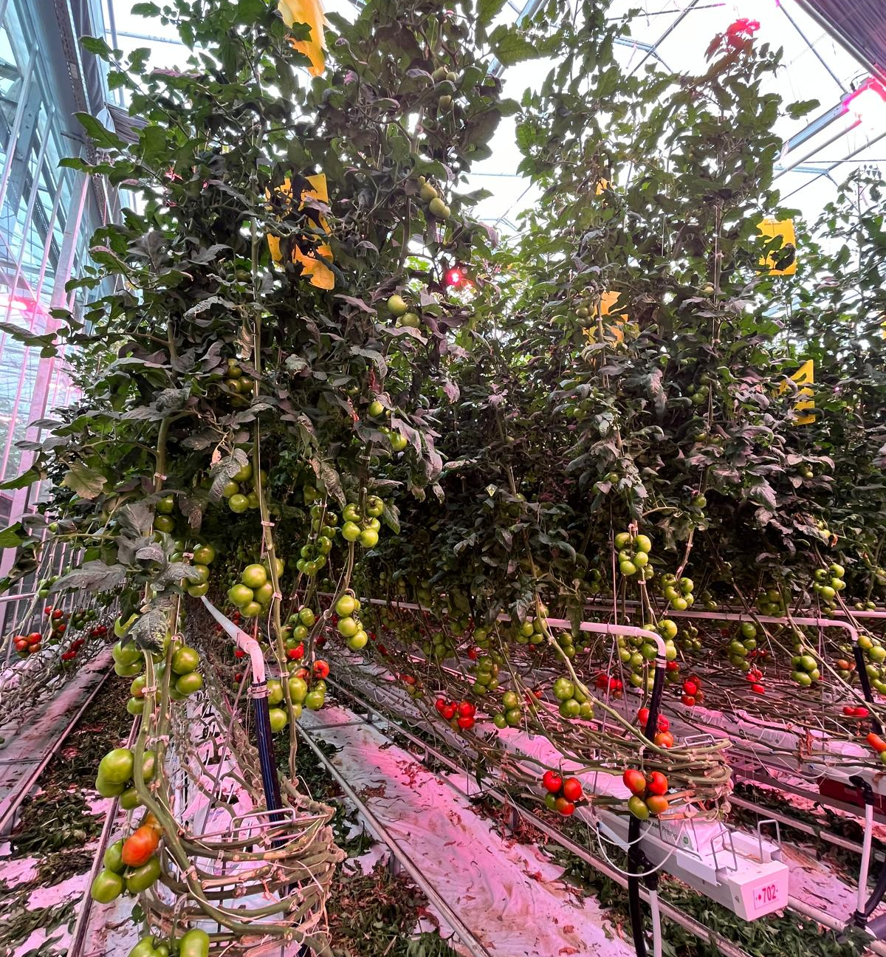
Greenhouse Visit Insights
After a keen discussion with the greenhouses, this modelling can help reduce the disease detection time & improve the quality of produce.
Image classification can help set the disease type into different stages helping the greenhouses to act differently by sending them to the lab for examination and understand which has to be treated in what way.
Overall, will boost efficiency, reduce labor and time consumed, and can act faster to reduce damage due to disease leading to crop yield optimization.

Slide 10
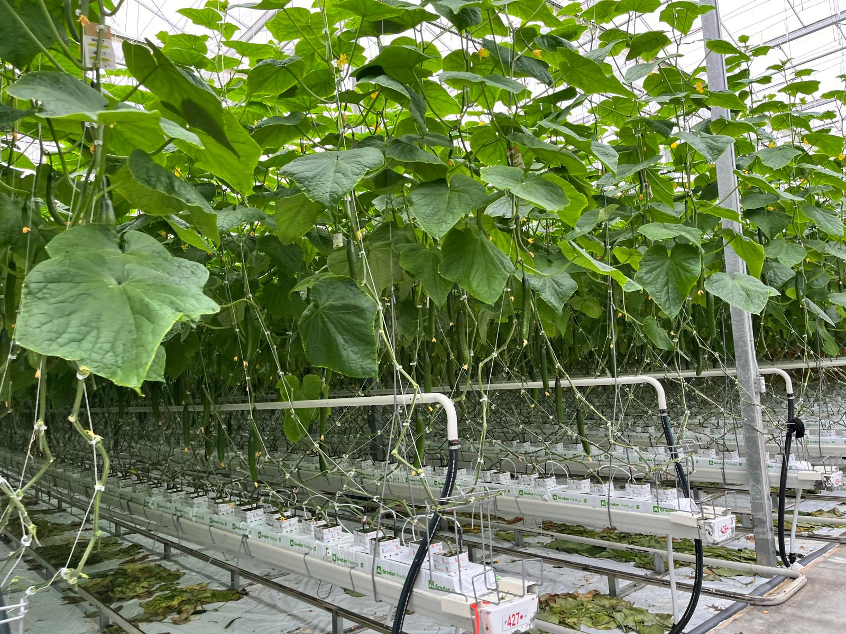


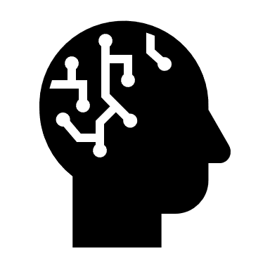
Machine Learning Models
CNN
VGG16
Yolov8s
Ability to analyze spatial patterns in image data, important for disease detection
Deep architecture and proven effectiveness in image classification tasks, enhanced accuracy.
Most suitable for efficient classification involving segmentation, identifying anomalies. Enormous Computational capacity and augmentation

Slide 11
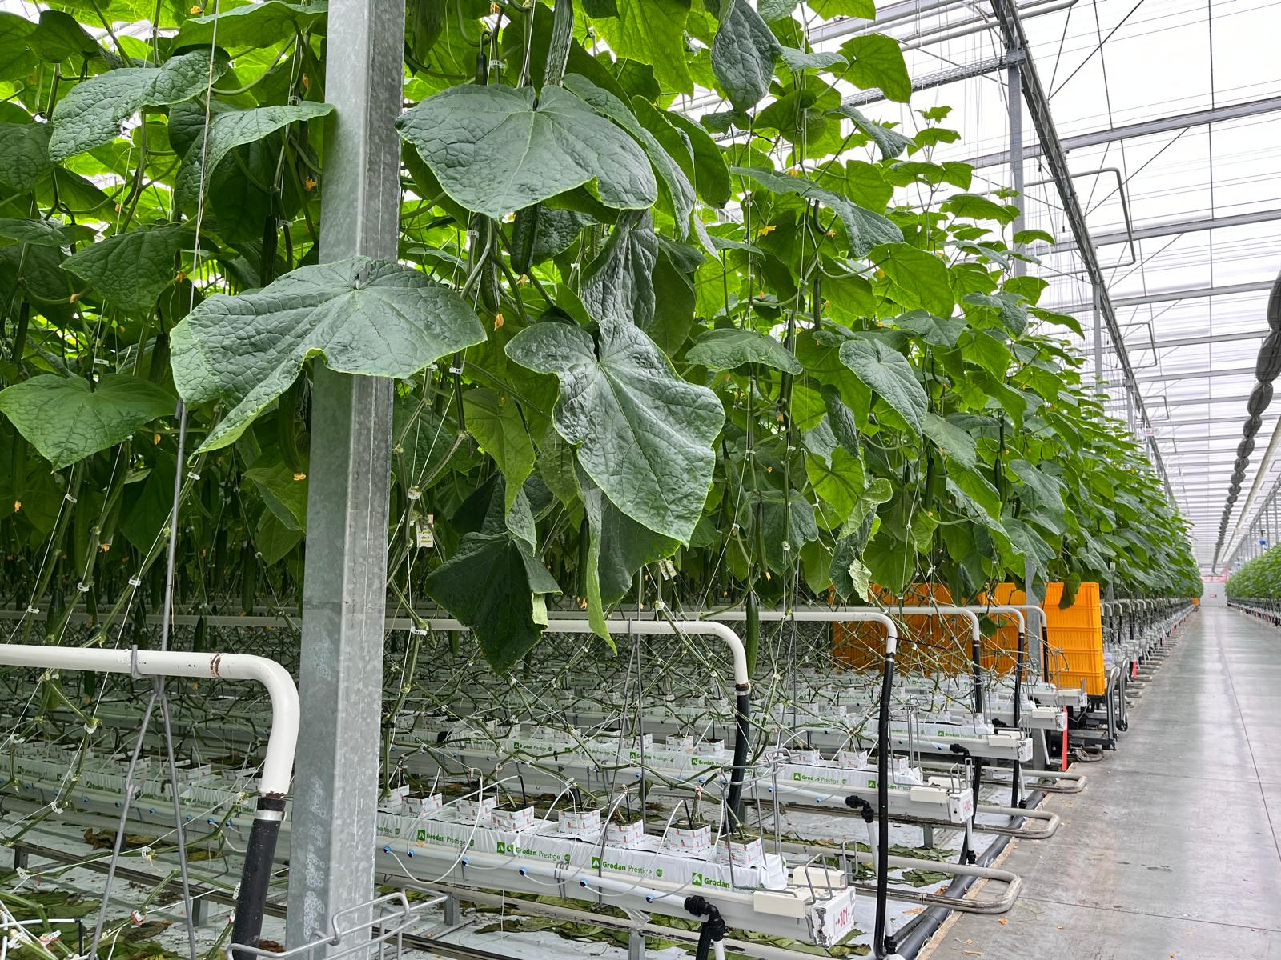
Roboflow: Yolov8sInstance Segmentation
Beyond simple image classification – not only identifies objects but also precisely labels individual instance of object within image.
Distinguishes between different instances of same class. For example: not only class dogs in image also segment different dog breeds.
Detailed object recognition, precise identification using enhanced visual insights

Slide 12
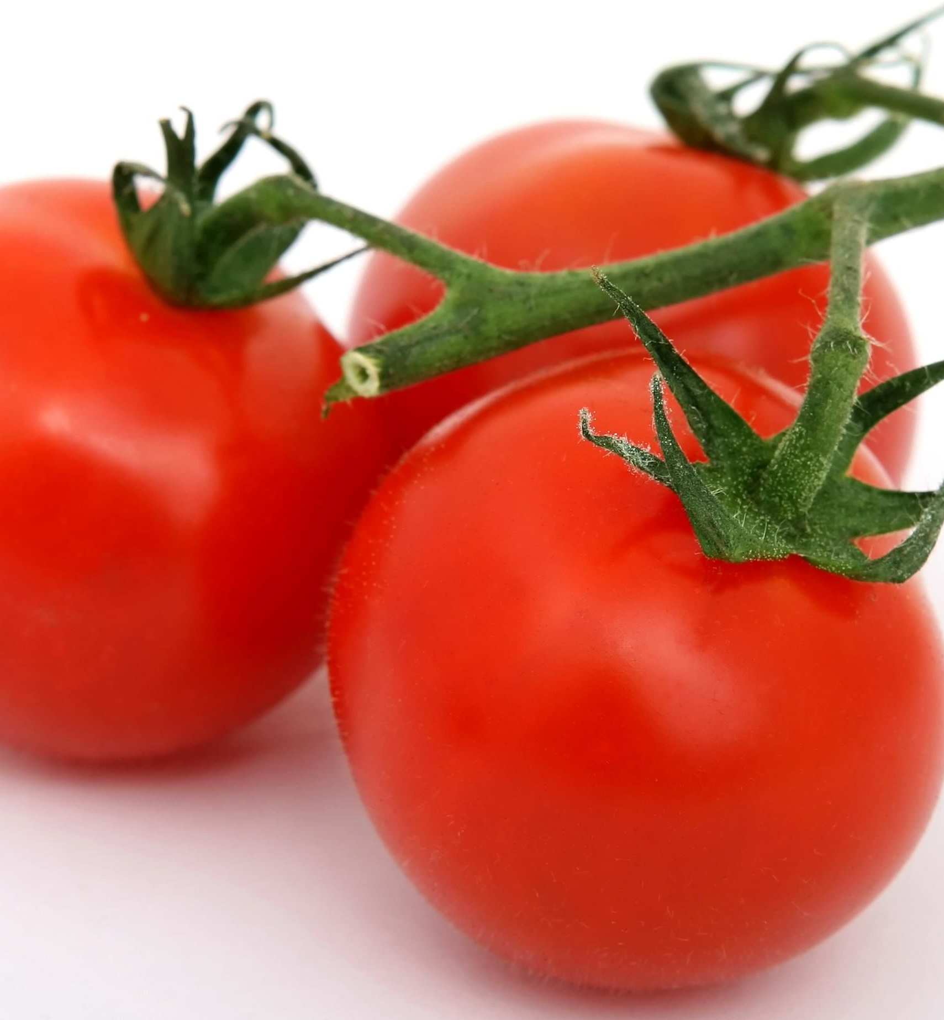
CNN & VGG16
CNN (Binary Classification)
Accuracy: 0.97
VGG16 (Multi Classification)
Accuracy: 0.33
VGG19 (Multi Classification)
Accuracy: 0.47

Slide 13
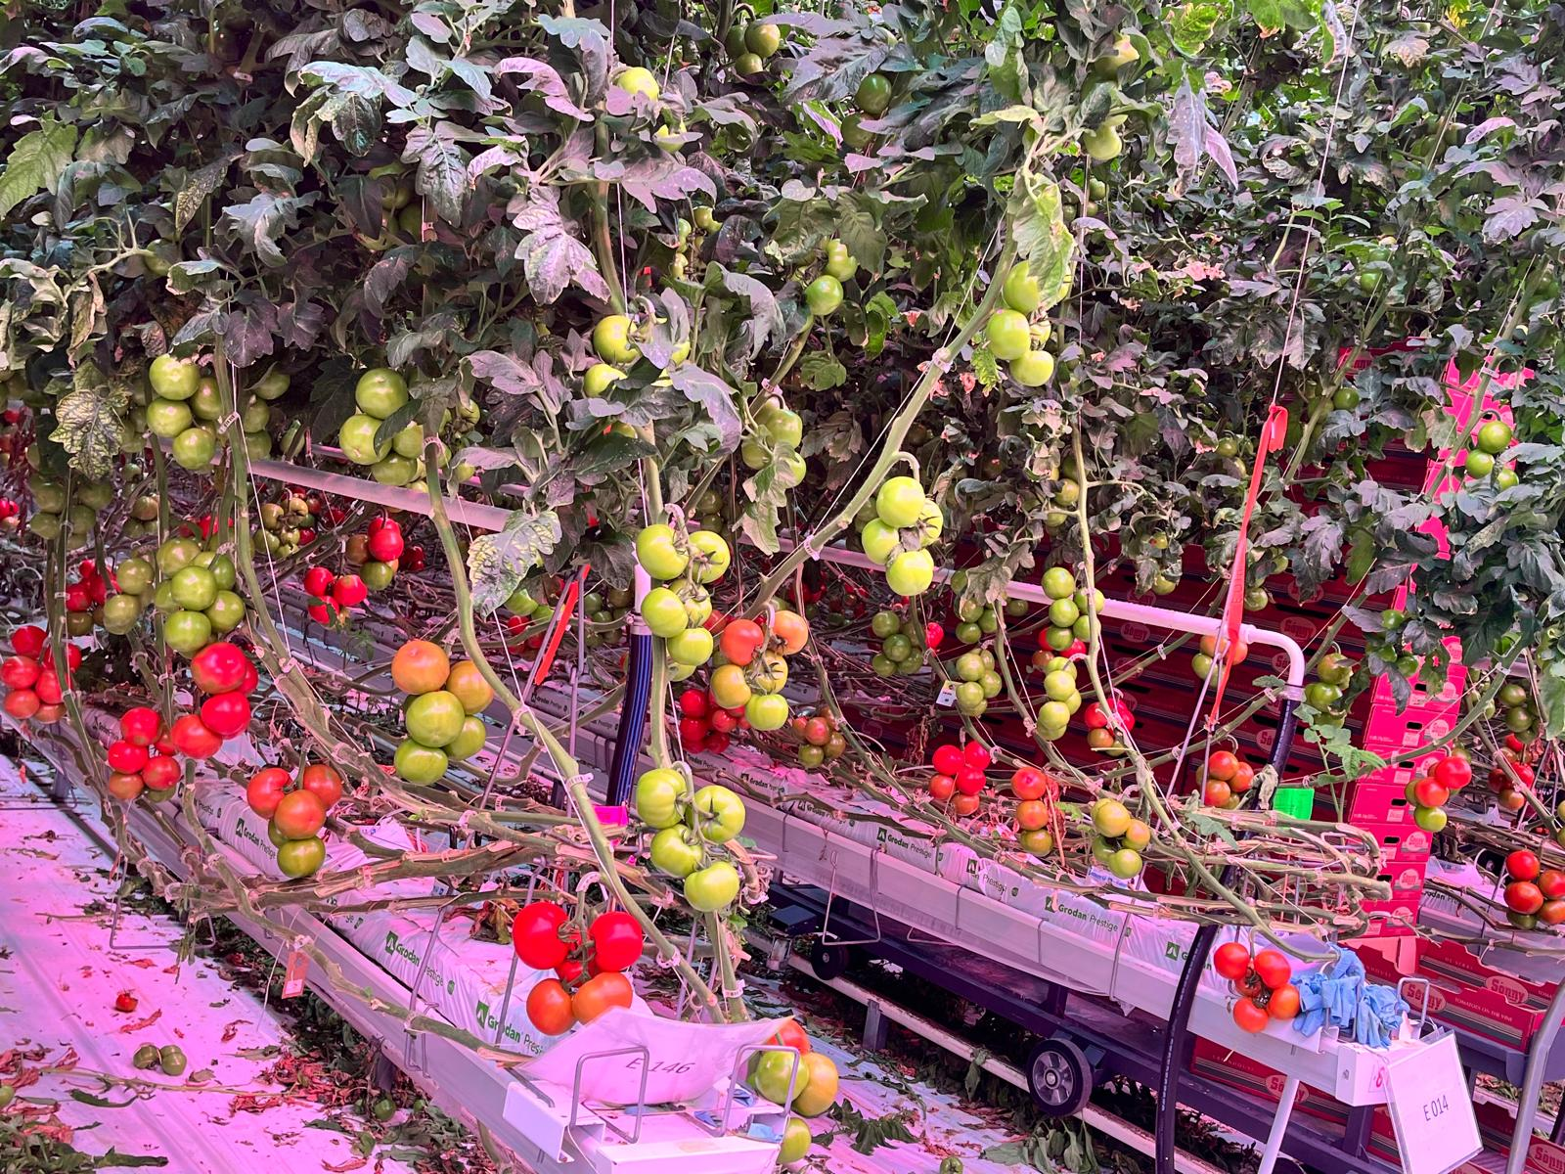
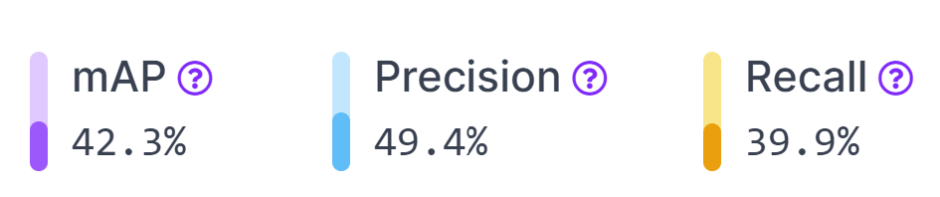
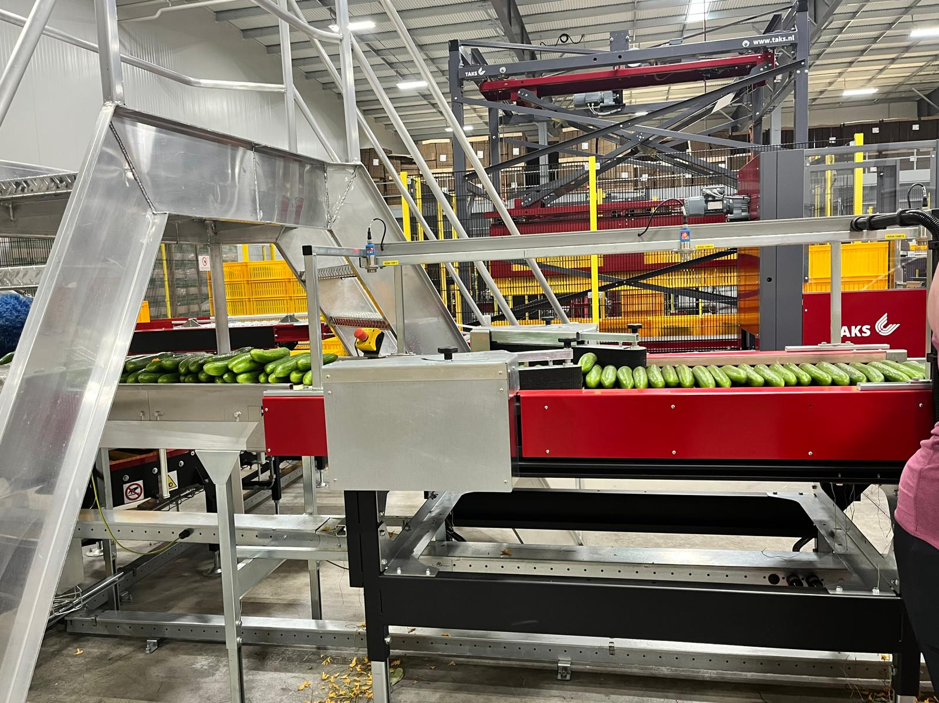
Model: Yolov8s
Model Type: Roboflow 3.0 Instance Segmentation (Fast)
Checkpoint:crop-disease-identification/8
Version: 9 Data Split Ration: 70:20:10

Slide 14




Use cases
Early Disease Detection
Resource Management
Yield Optimization
Quality Control
Early detection due to automation enables timely and targeted action
Better resource allocation including water, nutrients, pesticides and human resource
Approximate more efficiently on crop yields and plan accordingly
Less disease and anomalies ensures better quality

Slide 15
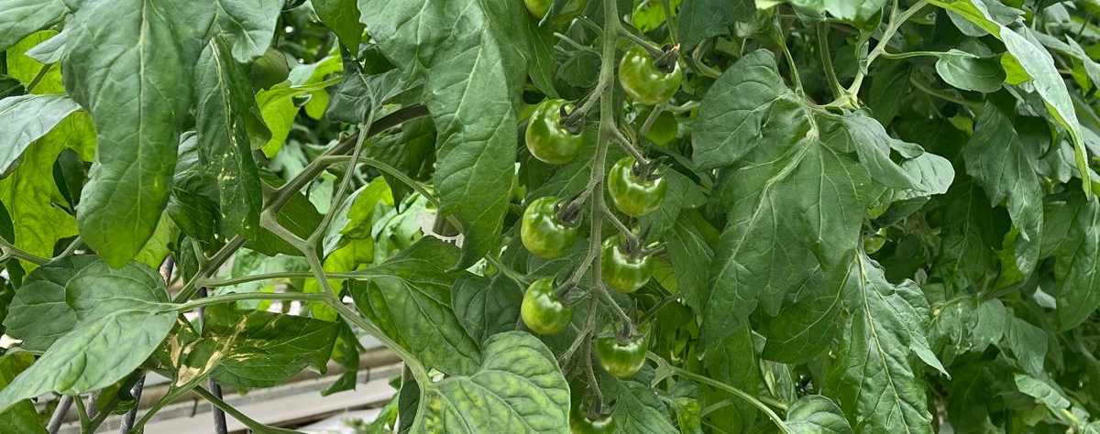
Challenges
Data Collection
Computational Limitations
Industry Knowledge
Required variables in a dataset crucial for crop yield prediction and/or optimization (soil nutrients, pesticides, and insecticides) were confidential.
Multiple attempts from multiple channels did not yield result for what was required.
Images collected had quality issues that had to be tackled efficiently.
Image dataset after augmentation resulted in huge dataset requiring proper pipeline and memory.
Code prepared to be run on python/google colab could not run all required epochs due to computational limit.
Less epochs created poor accuracy and generalization.
Considerable amount of time was spent on research and meeting industry experts including site visit to navigate through best practices and requirements to navigate through the project.

Slide 16

Thank You
b
This Photo by Unknown Author is licensed under CC BY-NC

Slide 17
References
https://www.sciencedirect.com/science/article/pii/S0168169920302301
https://www.nature.com/articles/s41598-023-42843-2
https://www.sciencedirect.com/science/article/pii/S0168169920302301#:~:text=Several%20machine%20learning%20algorithms%20have,in%20crop%20yield%20prediction%20studies
https://docs.roboflow.com/datasets/image-augmentation
https://www.statcan.gc.ca/en/data-science/network/greenhouse-detection
https://docs.ultralytics.com/#yolo-licenses-how-is-ultralytics-yolo-licensed
https://yolov8.com/

